Slide 1
Welcome Back Seniors
Time to get ready!
Last year is over…
Attendance WILL BE TAKEN!

Slide 2
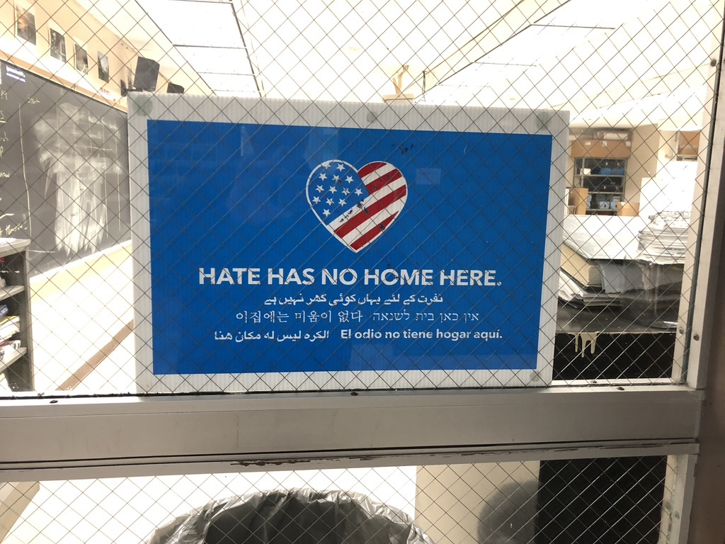

Slide 3
Let’s talk about attendance!
This is NO JOKE!

Slide 4
Let’s Play this game again.
On your index card please answer 4 of the following:
What is your favorite TV show?
What is your spirit animal?
What is your favorite movie?
What is your favorite sport to watch?
What is your favorite song?
What is your favorite sport to play?
What is your favorite holiday?
What is your desert island food?
What is your favorite color?
Who is your hero?
What is your favorite book?
What is your favorite hobby?
What is your most prized possession?
If you could go anywhere in the world, where would you go?

Slide 5
Who are you? The form is longer this year ☹
Fill out the student forms

Slide 6
Good news!
You can take this course and earn 4 credits at WCC it will count as BIOL 143/144 Environmental Science lec/lab
The cost is $265. This is 1/3 the cost of the course for college students! If you take it next year it will be $788 for a 4 credit course + fees which can bring the cost to $920.
The directions for application are on Schoolagy. Please discuss it with your parents.
I will be asking for a list of students interested next week.
It is MUCH MUCH MUCH better than AP.

Slide 7
Syllabus, Class Materials and Rules
Your syllabus and class description are available electronically on Schoology.
Marble lab notebook for lab, Separate Marble notebook for Tech Prep or a section in your lab notebook, outline book and class notebook.
HW/CW and entry/exit quizzes.
Are we a team? (It is better if we are, but we don’t have to be)
Lab coat, safety glasses and gloves. (and mask if you want)
Rules…Be KIND, be safe, be respectful, be nerdy!
Only one person out on a pass at a time. Sign out, sign back in. If you are going to be long, get a destination pass from me.

Slide 8
Our goals?? (same as last year)
To be scientists!
To have a thorough understanding of the scientific method.
To be able to function safely in a college or industrial lab setting.
To do meaningful research.
To develop a thorough understanding of Ecology and Environmental Science.
To be a successful college students (well for you to be successful and for me to be a good teacher)
To prepare you for the future.
To have fun.

Slide 9
CTE Hours…you need 55 ☺
It is not as hard as you think.
Work or volunteer in the field. Pharmacy tech, hospital, science barge, museum, doctor’s office, green team, eels, blue team. There is important paperwork that goes with this.
In school opportunities include, lab maintenance for me or any other science teacher, hydroponics set up, trout tank, trout trip, freshman Friday…
Keep track of hours. Have supervisor sign WBL sheet.
Get 55 hours.
Get a stamp on your diploma*
* you must pass class, precision test and tech prep ☺

